Slide 1
UMAP Dimensionality Reduction
UMAP (Uniform Manifold Approximation and Projection): A popular nonlinear dimensionality reduction technique based on the theory of manifold learning. This method examines the local structure in the data, constructs a weighted neighborhood graph of high-dimensional data, and uses the minimization of cross-entropy loss between high-dimensional and low-dimensional spaces to find a low-dimensional representation.
Before dimensionality reduction, the TCR data was divided into human and mouse categories, encoded by GIANA encoding.

Slide 2
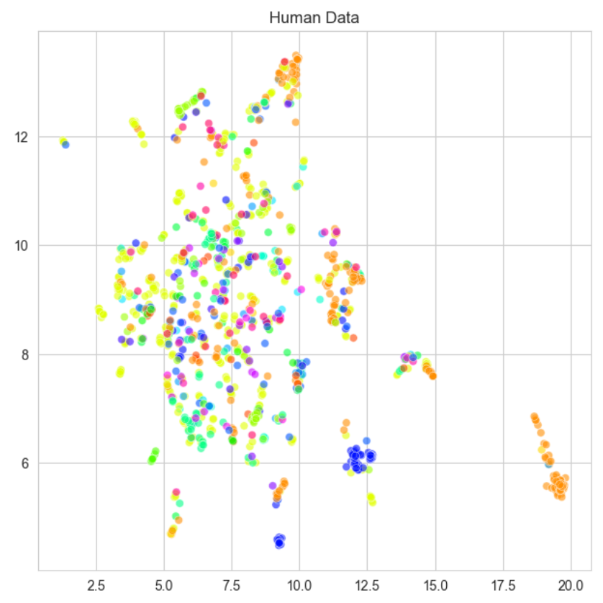
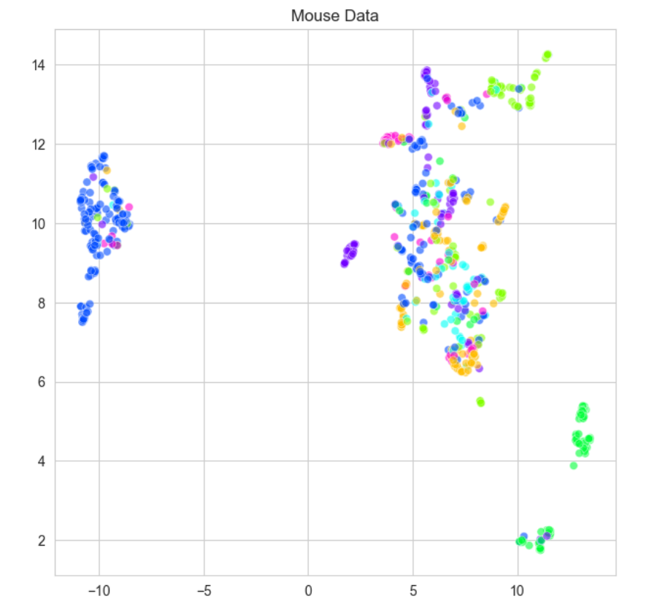
Human vs. Mouse
Results
Possible reasons
Human TCR:
More dispersed
Some small tightly clustered group
Different specificity mixed together and difficult to form distinct high-purity clusters
Mouse TCR:
Relatively compact
Obvious boundaries and distances between clusters
More concentrated specificity
Human:
Higher genetic diversity
More complex immune system
Exposure to a wide variety of pathogens in different environments
Complex distribution which hard to be captured by UMAP
Mouse:
Lower genetic diversity
Simpler immune system
Bred in the lab

Slide 3
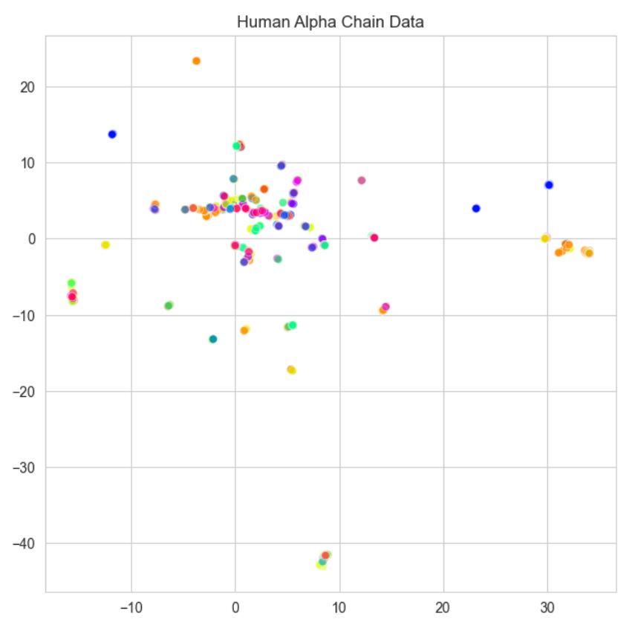
Alpha vs. Beta vs. Combined Chains
A large number of points overlap completely.
Many small dispersed clusters.
Alpha chains do not have a D region and only undergoes VJ rearrangement

Slide 4
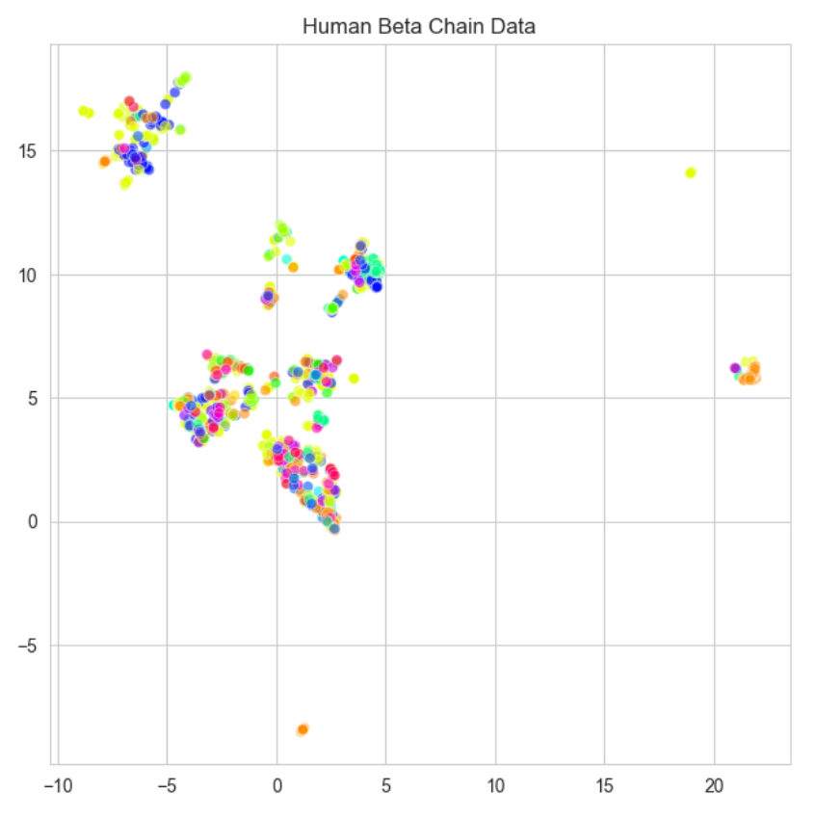
Alpha vs. Beta vs. Combined Chains
Clusters with relatively distinct boundaries.
Loose internally and closer together.
Clusters do not have higher purity.
Contains more V region and D region gene segments offering higher diversity.
Some TCR Beta chains are closer to each other.
A broader epitope recognition.

Slide 5
Alpha vs. Beta vs. Combined Chains
More dispersed
Different specificity mixed together and difficult to form distinct high-purity clusters
The different combinations of TCRs on the Alpha and Beta chains make the TCRs more diverse, leading to a more diverse distribution.
TCR epitope recognition is broadened by combining Alpha and Beta chains.

Slide 6
Clustering
2 Methods
DBSCAN: An effective density-based clustering method which can identified the clusters as high-density regions separated from low-density regions. It do not need the number of clusters and can find arbitrarily-shaped clusters. It cannot cluster data well with large differences in densities.
Hierarchical Clustering: A bottom-up clustering algorithm that gradually merges data points into clusters, and represents the similarity relationship between data points through a tree-like structure. It probes the data at different levels of granularity and can discover hierarchical structure.
3 Metrices
Pure Cluster Fraction: The percentage of pure clusters out of all clusters.
Pure Cluster Retention: The percentage of TCRs classified as pure clusters out of all TCRs.
Normalized Mutual Information(NMI): Twice the mutual information divided by the sum of the entropies of the two labels(cluster label and specificity).
Notes:
The shortcomings of DBSCAN and the advantages of hierarchical clustering are presented here.

Slide 7
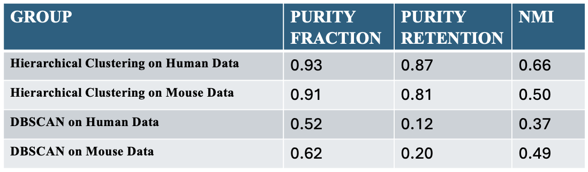
Human vs. Mouse
Hierarchical clustering performs better on human TCR and DBSCAN performs better on mouse TCR.
Human TCR data distribution have a more apparent hierarchical structure.
Mouse TCR density distribution is less dispersed or variable.

Slide 8
Agglomerative Hierarchical Clustering vs. DBSCAN
Purity fraction: DBSCAN results is half of hierarchical clustering.
Purity retention: DBSCAN is nearly only a quarter of hierarchical clustering.
NMI: DBSCAN has a relatively small gap with hierarchical clustering.
The density distribution of TCR chains can be very heterogeneous.
Hierarchical clustering is more robust and able to handle complex and variable TCR distributions

